Slide 1


DATA221 Intro Machine Learning 05 linear algebra
William Trimble
Spring 2022

Slide 2
Definition of eigenvectors and eigenvalues
square matrix
n x n
ith eigenvalue
eigenvalue e_{i}
eigenvector λ_{i}
ith eigenvector
n x 1
A e_{i} = λ_{i} e_{i}
n
A
e
e
=
square
matrix
n
λ_{i}
n x n
n x 1
n x 1

Slide 3
Eigenvalue decomposition
A = Sum_{i} e_{i}^{T} λ_{i} e_{i}
n
A
Q⁻¹
Σ
Q
λ₁
e₂
e₃
e₄
=
e₂^{T}
λ₂
n
e₃^{T}
λ₃
e₄^{T}
λ₄
square
matrix
eigenvectors
(orthogonal)
eigenvalues
(diagonal)
eigenvectors
(orthogonal)
A
Q⁻¹
Σ
Q

Slide 4
Eigenvalue decomposition
A = Sum_{i} e_{i}^{T} λ_{i} e_{i}
n
A
Q⁻¹
Σ
Q
λ₁
e₂
e₃
e₄
=
e₂^{T}
λ₂
n
e₃^{T}
λ₃
e₄^{T}
λ₄
Why does the matrix have to be square?
square
matrix
eigenvectors
(orthogonal)
eigenvalues
(diagonal)
eigenvectors
(orthogonal)
A
Q⁻¹
Σ
Q

Slide 5
Eigenvalue decomposition
A = Sum_{i} e_{i}^{T} λ_{i} e_{i}
n
A
Q⁻¹
Σ
Q
λ₁
e₂
e₃
e₄
=
e₂^{T}
λ₂
n
e₃^{T}
λ₃
e₄^{T}
λ₄
What happens if some of the eigenvalues are zero?
square
matrix
eigenvectors
(orthogonal)
eigenvalues
(diagonal)
eigenvectors
(orthogonal)
A
Q⁻¹
Σ
Q

Slide 6
Eigenvalue decomposition
A = Sum_{i} e_{i}^{T} λ_{i} e_{i}
n
A
Q⁻¹
Σ
Q
λ₁
e₂
e₃
e₄
=
e₂^{T}
λ₂
n
e₃^{T}
λ₃
e₄^{T}
λ₄
What happens when some of the eigenvalues are the same?
square
matrix
eigenvectors
(orthogonal)
eigenvalues
(diagonal)
eigenvectors
(orthogonal)
A
Q⁻¹
Σ
Q

Slide 7
Eigenvalue decomposition
A = Sum_{i} e_{i}^{T} λ_{i} e_{i}
n
A
Q⁻¹
Σ
Q
λ₁
e₂
e₃
e₄
=
e₂^{T}
λ₂
n
e₃^{T}
λ₃
e₄^{T}
λ₄
What happens when they aren’t zero but are small?
square
matrix
eigenvectors
(orthogonal)
eigenvalues
(diagonal)
eigenvectors
(orthogonal)
A
Q⁻¹
Σ
Q

Slide 8
Why eigenvalue decomposition?
Q
e₂
e₃
e₄
Orthonormal basis is often convenient
Orthonormal basis has a geometric interpretation; the directions the eigenvalues represent can help with gradient descent
Permits truncation by importance; small-eigenvalue eigenvectors contribute less to the final product; we can store (and calculate) instead of n x m can store only n x p and p x n.
How much memory does your computer have?
How large a square matrix can you hold in memory?
How large a square matrix will fit on your hard drive?

Slide 9
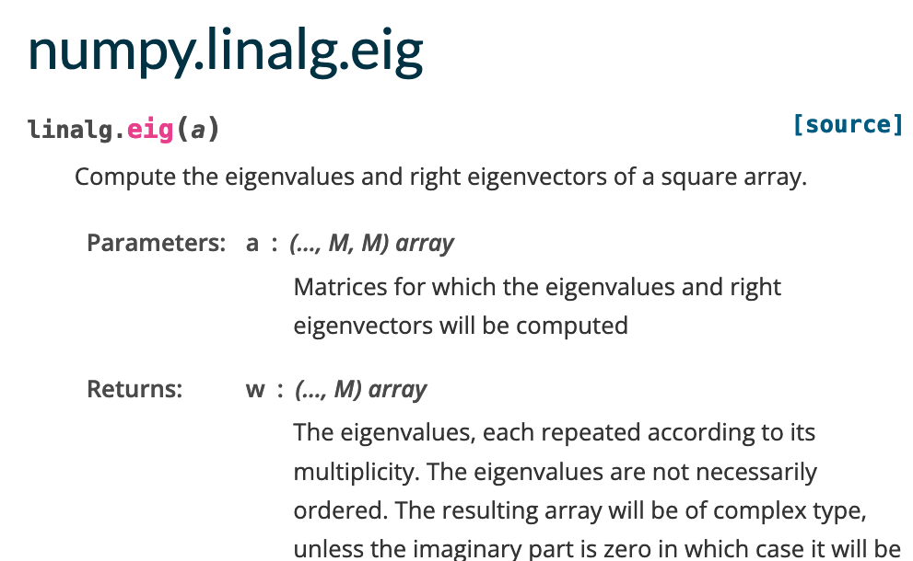

Σ
Q
λ₁
e₂
e₃
e₄
λ₂
λ₃
λ₄

Slide 10
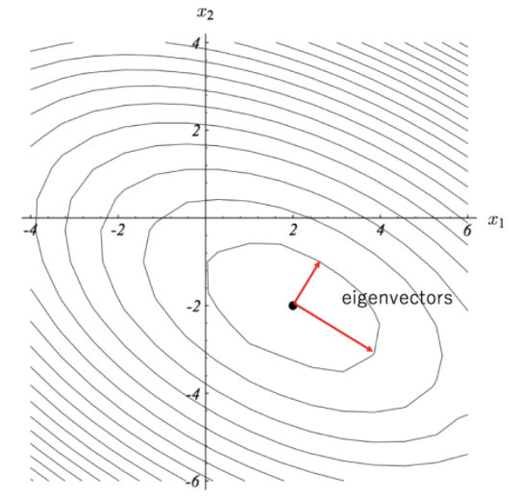
For covariance matrices and second-derivative matrices, there is a geometric interpretation.

Slide 11

If you can recall Taylor expansion…
y = f(x + Δx) = f(x₀) + $\frac{df}{dx}$ (x-x₀) + $\frac{1}{2}$ $\frac{d2f}{dx2}$(x-x₀)²

Slide 12
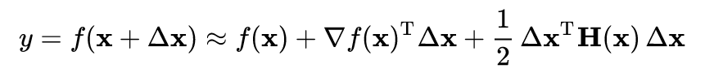

The multidimensional equivalent
y = f(x + Δx) = f(x₀) + $\frac{df}{dx}$ (x-x₀) + $\frac{1}{2}$ $\frac{d2f}{dx2}$(x-x₀)²

Slide 13
The multidimensional equivalent
y = f(x + Δx) = f(x₀) + $\frac{df}{dx}$ (x-x₀) + $\frac{1}{2}$ $\frac{d2f}{dx2}$(x-x₀)²
function
value at x
1st derivative
2nd derivative matrix

Slide 14
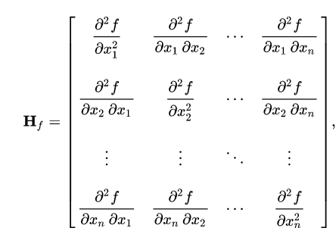
Hessian matrix
Take a scalar-valued function f(x₁, x₂, x₃… x_{n}).
The second derivative of this function is a n x n matrix:
Diagonals are the 2nd derivatives in the directions of the basis vectors e₁, e₂…
Off-diagonal terms measure essentially the same thing in different directions.
Matrix is symmetric, so eigenvalues are real. I can use eigenvalue decomposition to understand geometry of the function’s curvature.

Slide 15
Hessian matrix
Take a scalar-valued function f(x₁, x₂, x₃… x_{n}).
The second derivative of this function is a n x n matrix:
The eigenvalue decomposition of this matrix will tell you
the direction (in R^{n}) of maximum 2nd derivative curvature
the maximum curvature
the direction of second-maximum curvature…
the direction of third-maximum curvature…

Slide 16
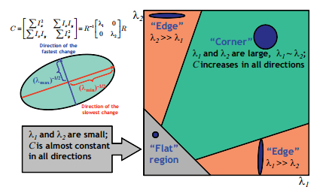
Hessian matrix
f(x₁, x₂, x₃… x_{n})…
https://stackoverflow.com/questions/22378360/hessian-matrix-of-the-image

Slide 17
Hessian matrix
f(x₁, x₂, x₃… x_{n})…
https://stackoverflow.com/questions/22378360/hessian-matrix-of-the-image

